Slide 1
Ensemble techniqueS of software prediction
Build by: Ujjwal Gupta(1809113115), Himanshi gupta(1900910139004), madhurika Sharma(1900910139005), Supriya gupta(1900910139008)
Development Guide by: Mrs. Yogita khatri

Slide 2
PRESENTATION OUTLINE
Introduction to Ensemble Learning?
Types of Ensemble Techniques
Bagging
Boosting
Bagging vs Boosting
Stacking
Max Voting
Averaging
Weighted Averaging
Rank Averaging
Conclusion (Ensemble methods)
Future Work
References

Slide 3
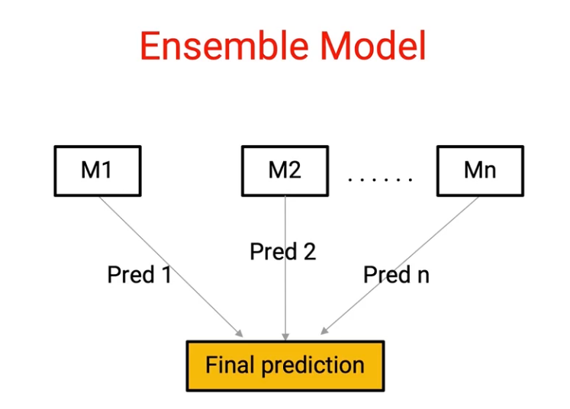
What is ensemble learning?
Ensemble learning is a machine learning paradigm where multiple models (often called “weak learners”) are trained to solve the same problem and combined to get better results.
The main hypothesis is that when weak models are correctly combined, we can obtain more accurate and/or robust models.

Slide 4
Example:
Let’s suppose we have ’n’ predictors/models:
Z1, Z2, Z3, ……., Zn with a standard deviation of σ
Variance(z) = σ²
If we use single predictors Z1, Z2, Z3, ……., Zn the variance associated with each will be σ² but the expected value will be the average of all the predictors.
Let’s consider the average of the predictors:
µ = (Z1 + Z2 + Z3+…….+ Zn)/n
If we use µ as the predictor then the expected value remains the same but see the variance now:
variance(µ) = σ²/n
So, the expected value remained ‘µ’ but variance decreases when we use an average of all the predictors. This is why taking mean is preferred over using single predictors.

Slide 5
Ensemble techniques:
There are few very popular Ensemble techniques which we will talk about in detail such as:-
BAGGING
BOOSTING
STACKING
MAX VOTING
AVERAGING
WEIGHTED AVERAGING
RANK AVERAGING

Slide 6
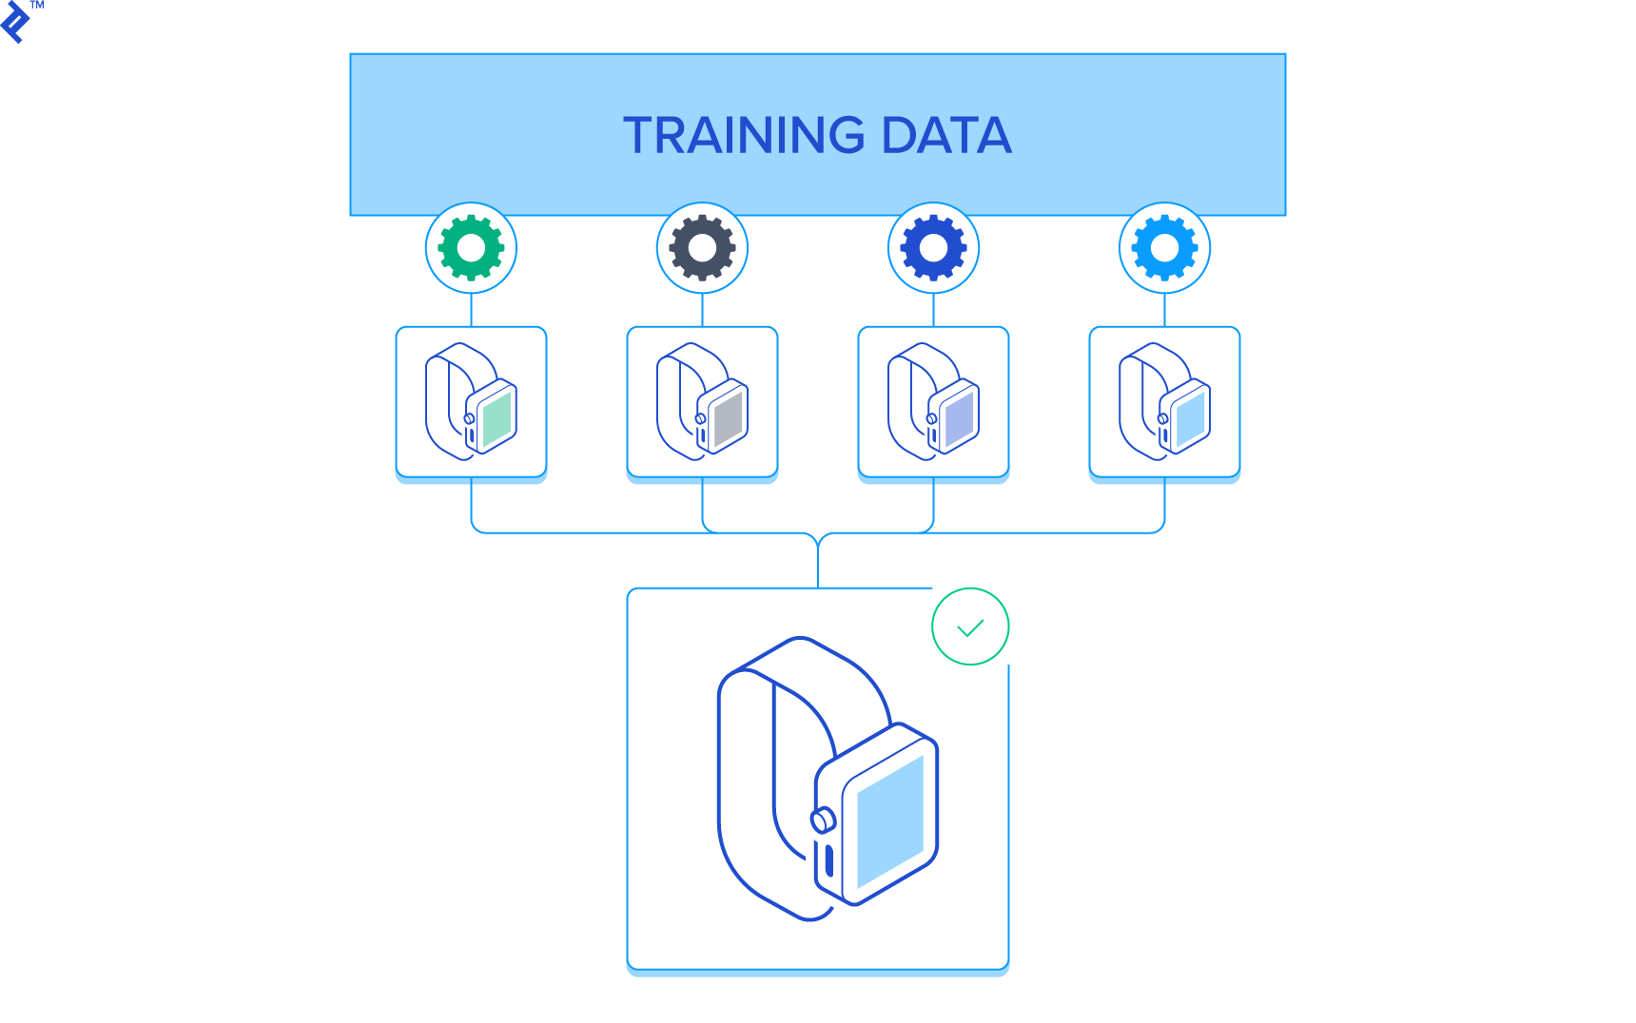
BAGGING:
Bagging stands for Bootstrap Aggregation.
Bagging is the type of ensemble technique in which a single training algorithm is used on different subsets of the training data where the subset sampling is done with replacement (bootstrap). Once the algorithm is trained on all the subsets, then bagging predicts by aggregating all the predictions made by the algorithm on different subsets.
For aggregating the outputs of base learners, bagging uses majority voting (most frequent prediction among all predictions) for classification and averaging (mean of all the predictions) for regression.

Slide 7
Advantages AND DISADVANTAGES of a Bagging Model:
ADVANTAGES
DISADVANTAGES
Bagging significantly decreases the variance without increasing bias.
Work so well because of diversity in the training data since the sampling is done by bootstrapping.
Works well with small datasets as well.
The main disadvantage of Bagging is that it improves the accuracy of the model at the expense of interpretability i.e., if a single tree was being used as the base model, then it would have a more attractive and easily interpretable diagram, but with the use of bagging this interpretability gets lost.
During sampling, we cannot interpret which features are being selected i.e., there are chances that some features are never used, which may result in a loss of important information.

Slide 8
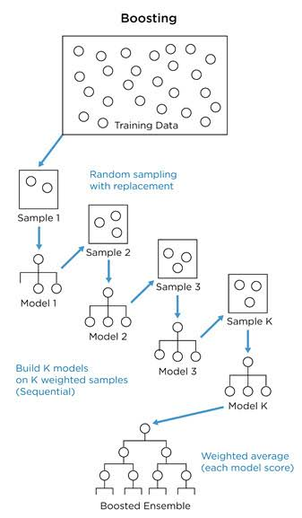
BOOSTING:
The term ‘Boosting’ refers to a family of algorithms which converts weak learner to strong learners. Boosting is an ensemble method for improving the model predictions of any given learning algorithm. The idea of boosting is to train weak learners sequentially, each trying to correct its predecessor. The weak learners are sequentially corrected by their predecessors and, in the process, they are converted into strong learners.
Boosting is mainly focused on reducing bias.

Slide 9
Advantages AND DISADVANTAGES of a BOOSTING Model:
ADVANTAGES
DISADVANTAGES
Boosting is a resilient method that curbs over-fitting easily.
Provably effective
Versatile can be applied to a wide variety of problems.
A disadvantage of boosting is that it is sensitive to outliers since every classifier is obliged to fix the errors in the predecessors. Thus, the method is too dependent on outliers.
The method is almost impossible to scale up. This is because every estimator bases its correctness on the previous predictors, thus making the procedure difficult to streamline.

Slide 10
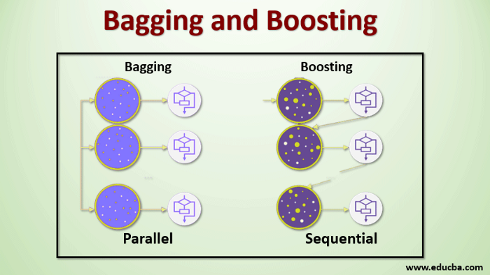
DIFFERENCE BETWEEN:
BAGGING
BOOSTING
Bagging rarely gets a better bias/outcome, if a single model gets a low performance.
Bagging can increase the generalization ability of the model and help it better predict the unknown samples.
Boosting can generate a combined model with lower errors., as it optimizes the advantages and reduces the pitfalls of the single model.
Boosting does not effect/have negligible effect on the generalization ability of model.

Slide 11
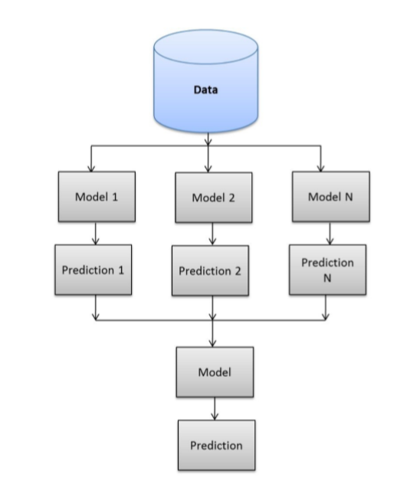
STACKING:
Stacked Generalization or “Stacking” for short is an ensemble machine learning algorithm.
Stacking is an ensemble learning method that combines multiple machine learning algorithms via meta-learning, In which base level algorithms are trained based on a complete training data-set, the meta-model is trained on the final outcomes of the all base-level model as a feature.

Slide 12
Advantages AND DISADVANTAGES of a STACKING Model:
advantages
DISADVANTAGES
The benefit of stacking is that it can harness the capabilities of a range of well-performing models on a classification or regression task and make predictions that have better performance than any single model in the ensemble.
Stacking improves the model prediction accuracy.
As we are taking the whole dataset for training for every individual classifier, in the case of huge datasets the computational time will be more as each classifier is working independently on the huge dataset.

Slide 13
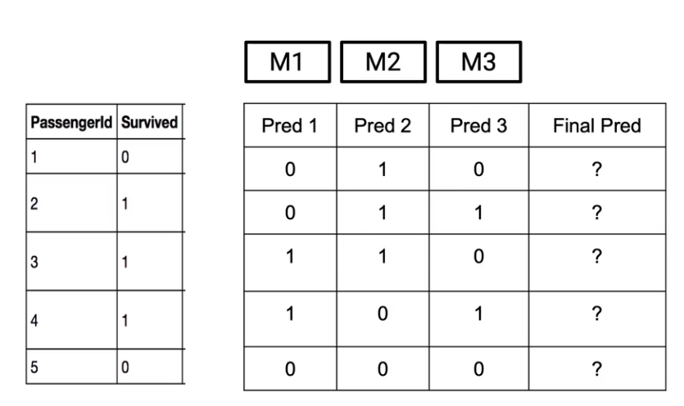
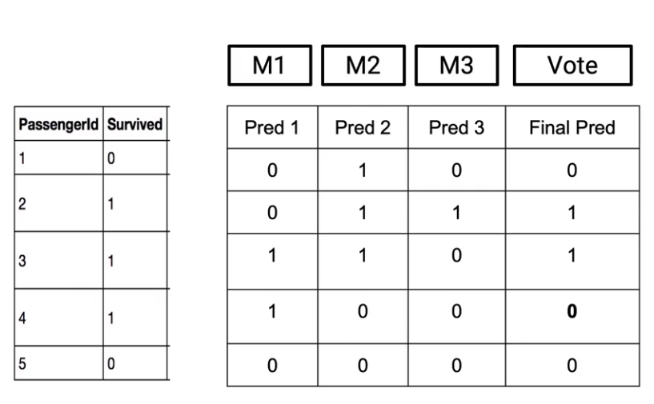
MAX VOTING:
If more models are telling me that a passenger would survive, I will consider the passenger survived. Whereas if more models are telling me that the passenger did not survive, I will predict that the passenger did not survive.

Slide 14
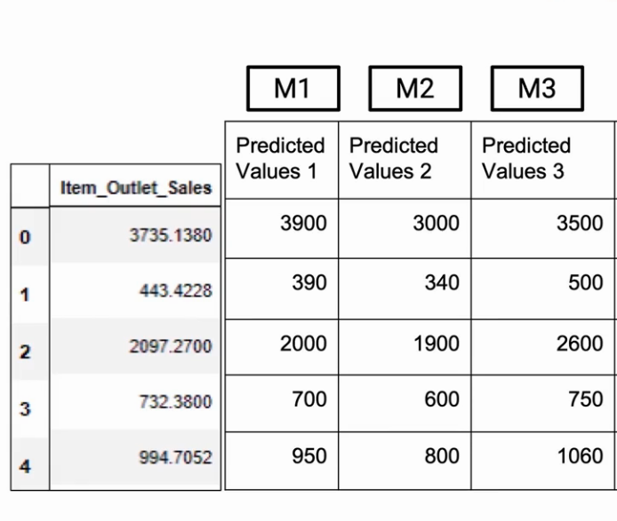
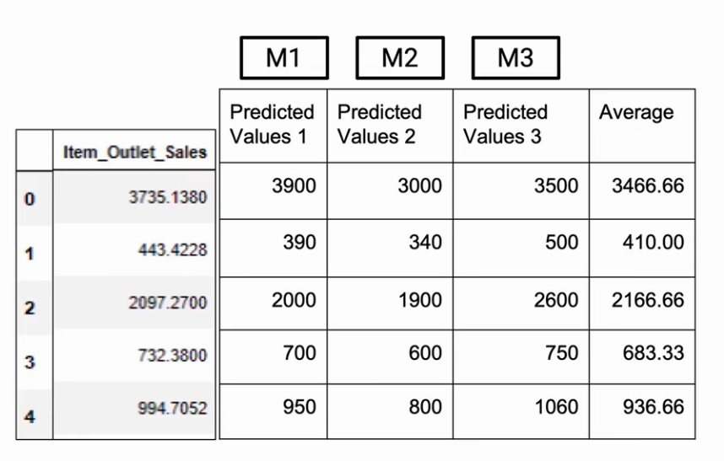
AVERAGING:
Let’s have three different models M1, M2, and M3 which are giving us individual predictions, and what we need is make the final prediction. So we’ll just take an average of whatever individual models are telling. So in this particular example for Row 0, we got an average of 3466.66 . So that would be our prediction.

Slide 15
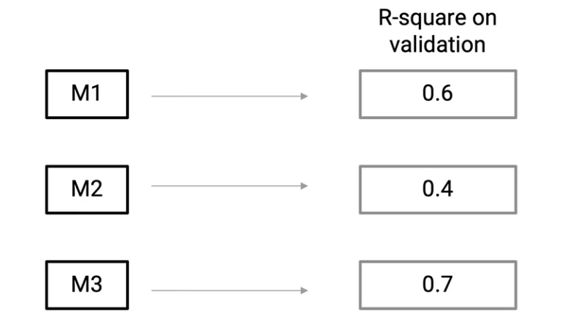
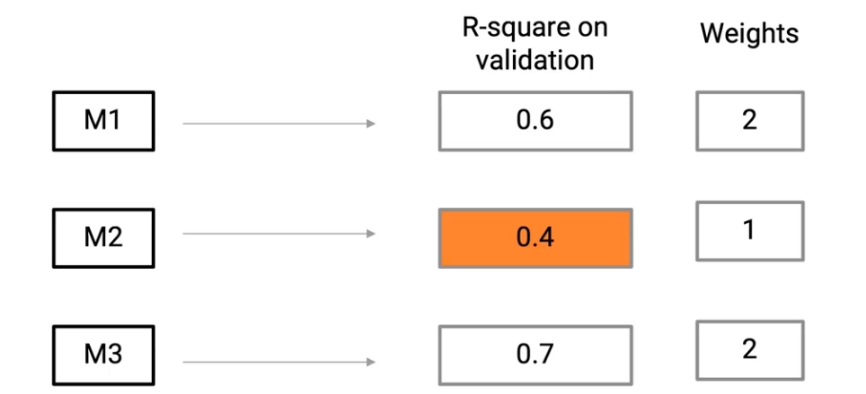
WEIGHTED AVERAGING:
Let’s say that these three models M1, M2, and M3 have an R-square on validation of 0.6, 0.4, and 0.7 respectively(Figure 1). This means that M2 is not performing great as compared to M1 and M3. So M3 is the best model. And M2 is the worst model.
Since in this particular case, model M2 is not the best model, so we’ll give it a lower weight whereas M1 and M3 are better models, so we’ll give them higher weights(Figure 2).
Figure 1
Figure 2

Slide 16
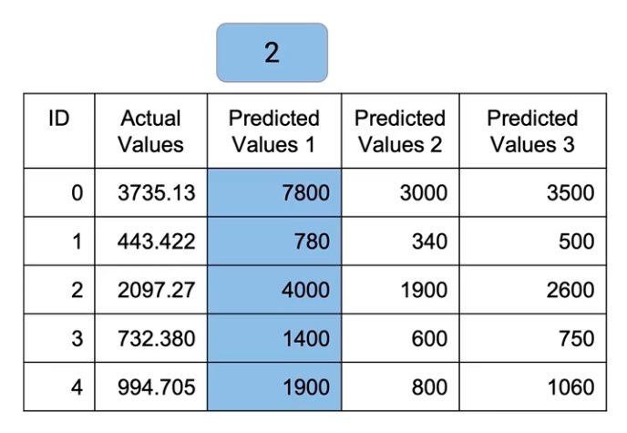
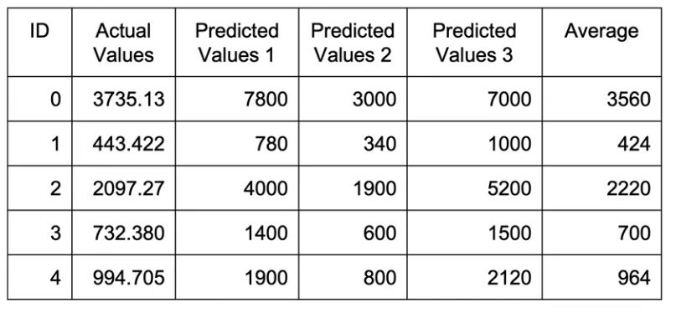
Basically multiply these weights to individual predictions and then take their mean. So M1 predictions which are, 3900, 390, etc, we’ll multiply them by a factor of 2.
Similarly, we’ll multiply M2 by a factor of 1. So basically no values change there. And M3, we’ll multiply by a factor of 2 again.
So we have taken weighted average from these models which gives a better result(Figure 4).
Figure 3
Figure 4

Slide 17
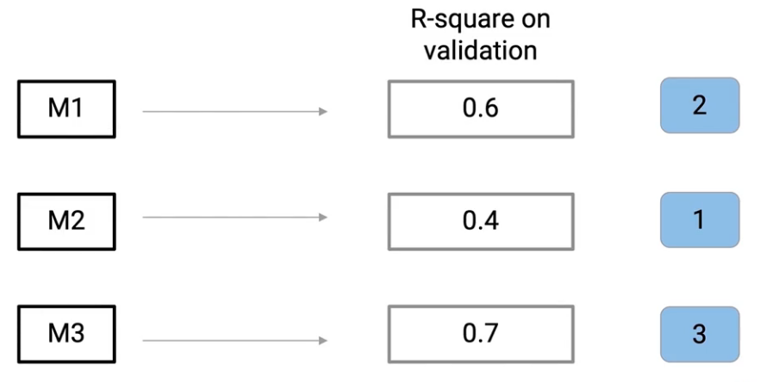
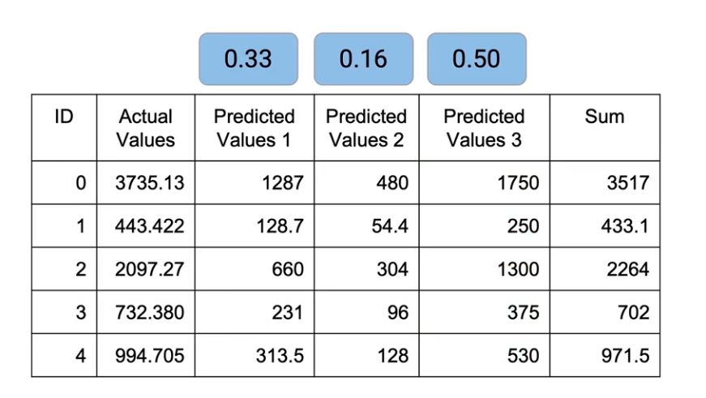
RANK AVERAGING:
Figure 1
Figure 2

Slide 18
So a quick thing to remember over here is that we’re giving rank 1 to the worst-performing model. So rank 1 is to the model which performs the least, rank 2 is the next best model, and rank 3 is the next best model(Figure 1). So we give these ranks to each of these models and then we take weights from these ranks. So basically summing up these ranks and divide each of these ranks by that total value.
We’ve already done the normalization at the time of taking weights, so we just need to sum them up. And this is what we get as the final outcome(Figure 2). And this is Rank Averaging.

Slide 19
conclusion:
Finally, we would like to conclude by reminding that ensemble learning is about combining some base models to obtain an ensemble model with better performances/properties. Thus, even if bagging, boosting, and stacking are the most commonly used ensemble methods, variants are possible and can be designed to better adapt to some specific problems.
Nonetheless, the effectiveness of these methods are undeniable, and their benefits in appropriate applications can be tremendous.

Slide 20
FUTURE WORK:
One interesting question we plan to investigate is how effective a single classifier approach might be if it was allowed to use the time it takes the ensemble method to train multiple classifiers to explore its concept space.
We plan to compare Bagging and Boosting methods to other methods introduced recently. In particular we intend to examine the use of Stacking as a method of training a combining function, so as to avoid the effect of having to weight classifiers.
The goal will be to create a learner where you can essentially push a start button and let it run. To do this we would try to preserve the benefits of Boosting while preventing overfitting on noisy data sets.

Slide 21
REFERENCES:
(NASA 2015) https://www.nasa.gov/sites/default/files/files/Space_Math_VI_2015.pdf.
Somya Goyal, Pradeep Kumar Bhatia, “Empirical Software Measurements with Machine Learning”, Computational Intelligence Techniques and Their Applications to Software Engineering Problems. Boca Raton: CRC Press, pp. 49-64. 2021. https://doi.org/10.1201/9781003079996
Somya Goyal, Anubha Parashar, ”Machine Learning Application to Improve COCOMO Model using Neural Networks”, International Journal of Information Technology and Computer Science (IJITCS2018). Vol. 10, No. 3, pp. 35-51. March 2018. DOI: 10.5815/ijitcs.2018.03.05
Goyal S., Bhatia P.K., “Feature Selection Technique for Effective Software Effort Estimation Using Multi-Layer Perceptrons. In: Proceedings of ICETIT 2019. Lecture Notes in Electrical Engineering, Springer, Cham. vol 605. pp 183-194. 2020. https://doi.org/10.1007/978-3-030-30577-2_15
Somya Goyal, Pradeep K. Bhatia, “GA based dimensionality reduction for effective software effort estimation using ANN”, advances and applications in mathematical sciences, Mili Publications, Vol. 18, Issue 8, Pages 637-649. June 2019.
B. Kitchenham and S. Charters, ‘‘Guidelines for performing systematic literature reviews in software engineering version 2.3,’’ Engineering, vol. 45, no. 4, p. 1051, 2007.
F. Anwer and S. Aftab, ‘‘Latest customizations of XP: A systematic literature review,’’ Int. J. Mod. Educ. Comput. Sci., vol. 9, no. 12, pp. 26–37, 2017.

Slide 22
THANK YOU

